Slide 1
Question 123.17.1
The useful work that comes from and engine is equal to
-W
Q
ΔE_{int}
PV

Slide 2
Δx
P
F_{gas}
F_{external}
Q
V
V_{i}
V_{f}

Slide 3
Hot Reservoir at T_{h}
Q_{h}
Q_{c}
Cold Reservoir at T_{c}

Slide 4
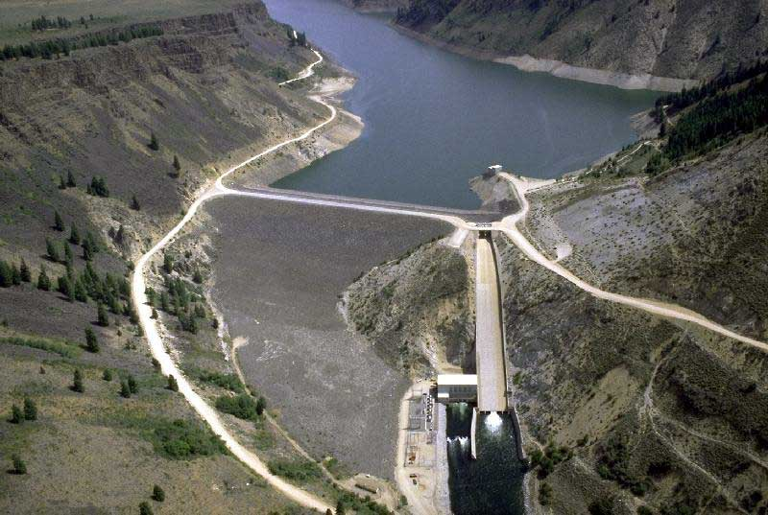
The picture shows the Anderson Ranch Dam and Reservoir.
If I take out a cup of water out of the reservoir, how much do the volume and the pressure of the water change?
Volume goes up, pressure down
Volume goes down pressure goes up
c) Volume goes down pressure goes down
d) You wouldn’t notice any difference

Slide 5
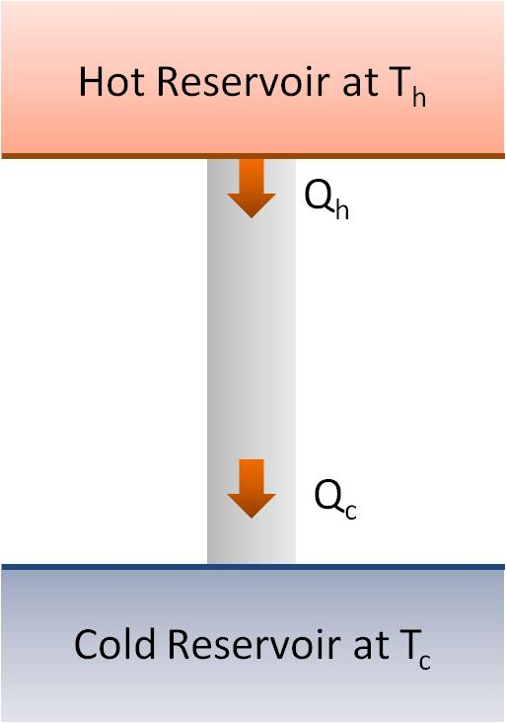
Question 123.17.2
By how much does the temperature of the hot reservoir change as Q_{h} leaves?
0K
10K
100K
1000K

Slide 6
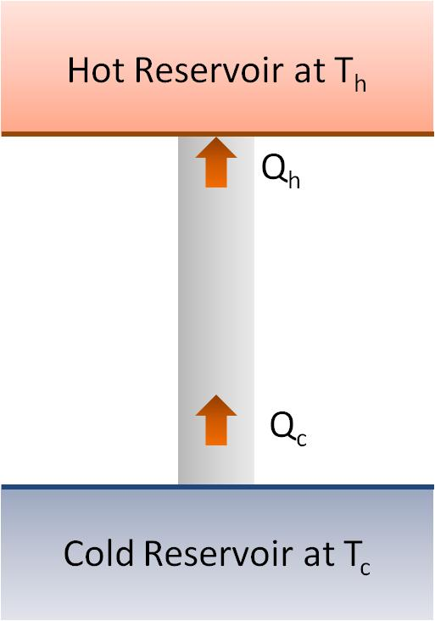
Question 123.17.3
What would you call the process shown in the energy transfer diagram
Adiabatic
Isobaric
Isothermal
Impossible

Slide 7
Question 123.17.4
What does the energy transfer diagram mean?
Heat is turned into useful work
Work is turned into waste energy
Energy is turned into useful work
This is an impossible process

Slide 8
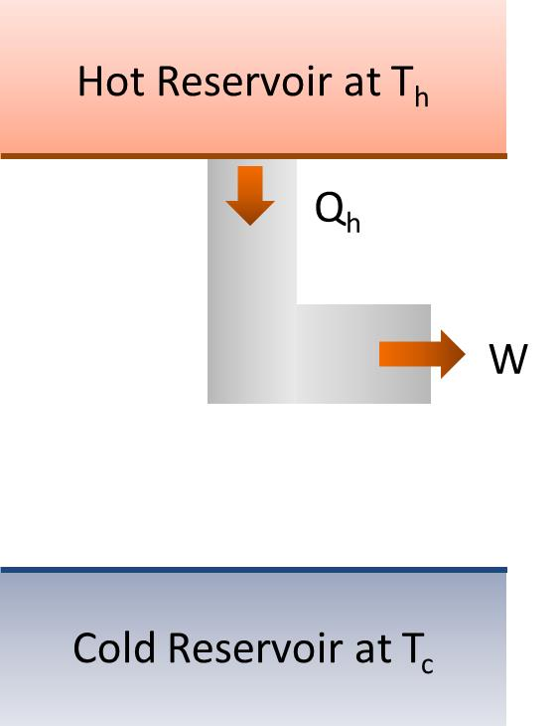
Question 123.17.4.5
What would you call the process shown in the energy transfer diagram
Adiabatic
Isobaric
Isothermal
Impossible

Slide 9
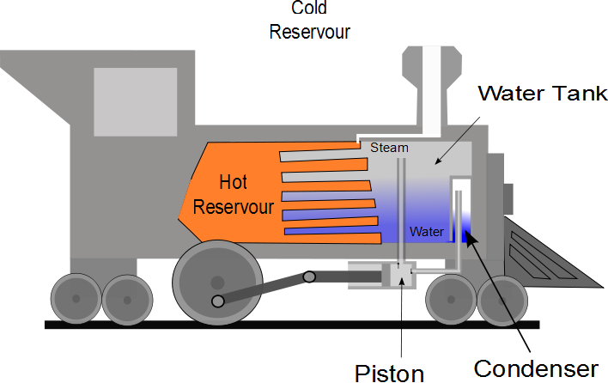

Slide 10
P
W_{eng} = Area
V

Slide 11
Question 123.17.5
Suppose I tell you I have an engine that has and efficiency e=1, what is Q_{c} for this engine?
0
W_{eng}+ Q_{h}
W_{eng}- Q_{h}
W_{eng}

Slide 12
Question 123.17.6
If I tell you I have a heat engine which operates with Q_{c} = 0, what should you do?
Buy Stock in my company
See if you can get your hands on the secret plans
Applaud the wonderful engineering achievement
Tell me I am lying (Kindly, this is BYU-I)

Slide 13
Question 123.17.7
It is a hot day. You don’t have and air conditioner, but you have a refrigerator. You open the door of the fridge. The air in your apartment
Gets cooler
Gets hotter
Stays the same
Can’t tell

Slide 14
Hot Reservoir at T_{h}
Q_{h}
Refrigerator
W
Q_{c}
Cold Reservoir at T_{c}

Slide 15
Hot Reservoir at T_{h}
Q_{h}
Q_{c}
Cold Reservoir at T_{c}

Slide 16
Hot Reservoir at T_{h}
Q_{h}
Q_{c}
Cold Reservoir at T_{c}

Slide 17
Hot Reservoir at T_{h}
W
Q_{c}
Cold Reservoir at T_{c}

Slide 18
Hot Reservoir at T_{h}
Q_{h}
W
Cold Reservoir at T_{c}

Slide 19
Hot Reservoir at T_{h}
Q_{h}
W
Cold Reservoir at T_{c}

Slide 20
Hot Reservoir at T_{h}
Q_{h}
Engine
W_{engine}
Q_{c}
Cold Reservoir at T_{c}

Slide 21
Hot Reservoir at T_{h}
Q_{h}
Engine
W_{engine}
Cold Reservoir at T_{c}

